Slide 1

Stock Market data Analysis
Group No :5
Deepa
Mentor:- KARTHIK MUSKULA

Slide 2
Business Problem
The objective of the analysis is to identify purchasing and selling patterns by carefully analyzing the data to help the investors

Slide 3
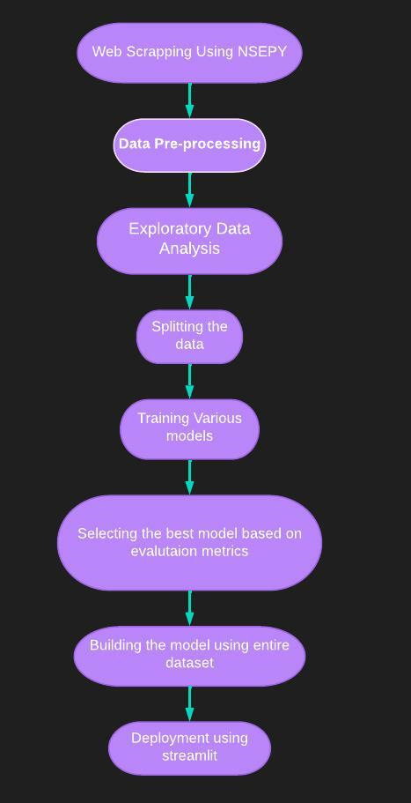
Project Flow Chart

Slide 4
Exploratory Data Analysis
We have extracted historical data's of 4 different companies using nsepy library
2 Stock’s from banking sector :-
-State Bank Of India
-Axis Bank
2 Stock’s from automobile sector:-
-Maruti Suzuki India Ltd
-Ashok Leyland Ltd

Slide 5
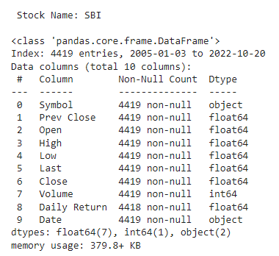
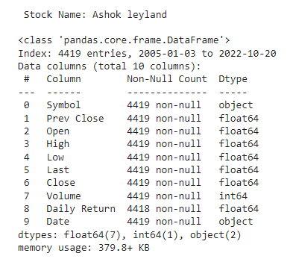
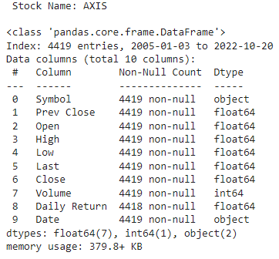
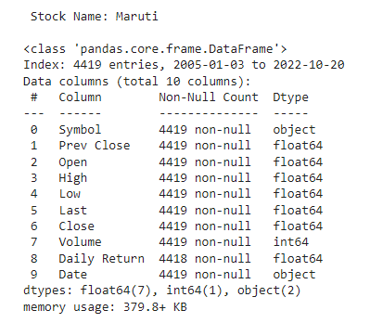
Data set consist of historical data from 2005. (17 year of data)
Data set of each company consist of 4419 row’s and 10 columns.
There are no null, Missing values present in the data set’s.

Slide 6
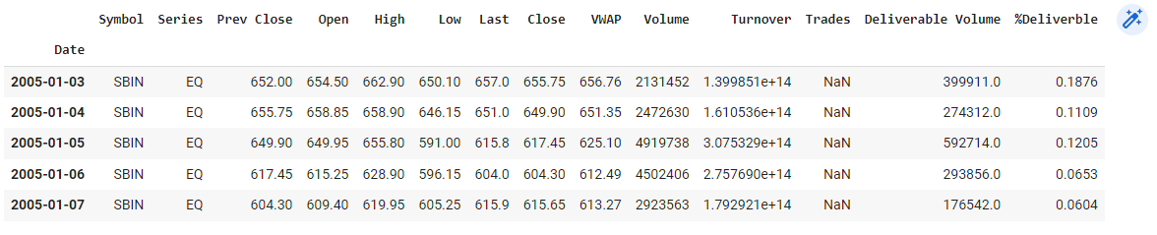
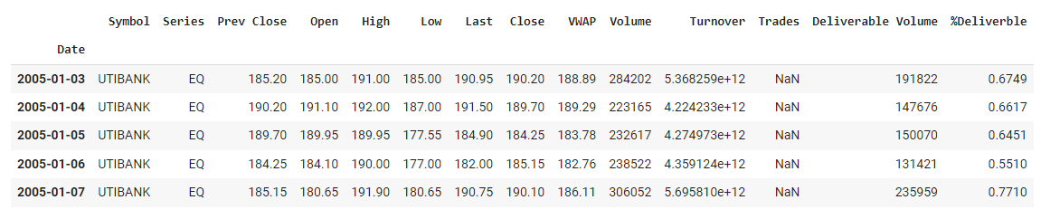
AXIS Bank
SBI
The head of the dataset, gives an idea about the data’s in each columns

Slide 7
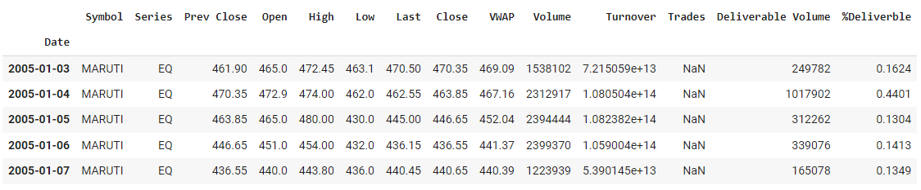
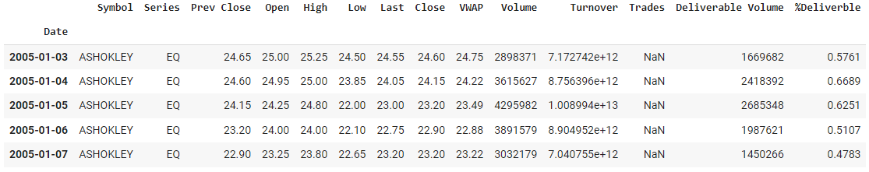
Ashok Leyland
Maruti
The head of the dataset, gives an idea about the data’s in each columns

Slide 8
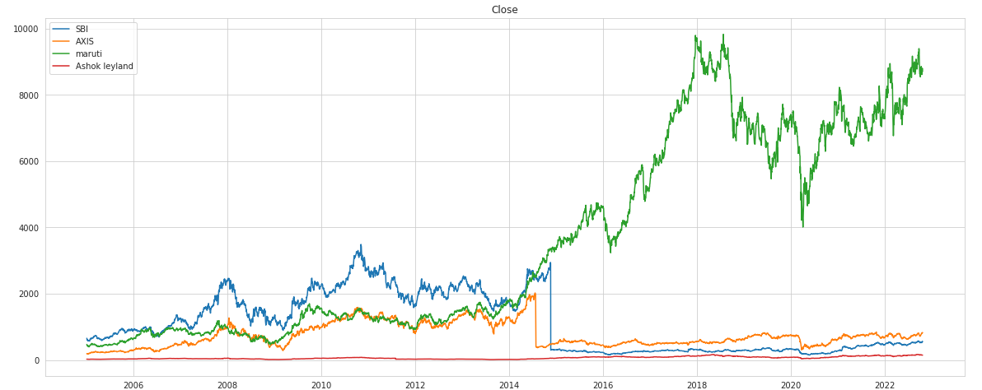
Line plots-Close price
Gives an idea about the variation of close price over 15 years
The Maruti stock price has highest increase, and the Leyland stock is having the least change in the close price.
During the year there is drop in close price of the banking sector stocks
There is drop in Maruti stocks during the 2020 region due to covid-19

Slide 9
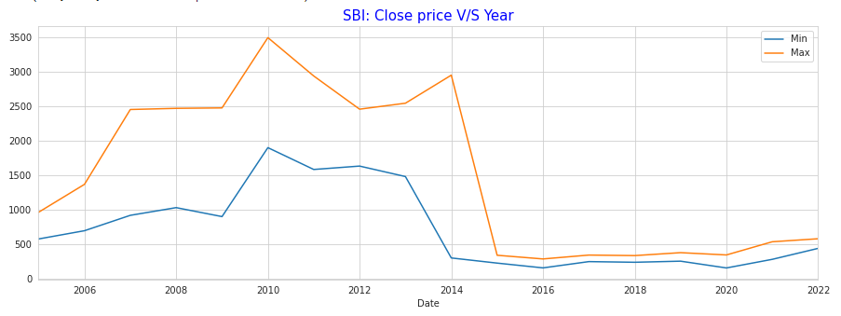
Close price V/s Year
This plot show the minimum and maximum close price for each year.
The max close price was observed during 2010 which was close to 3500.
The min Close price was observed during the 2016,2020

Slide 10
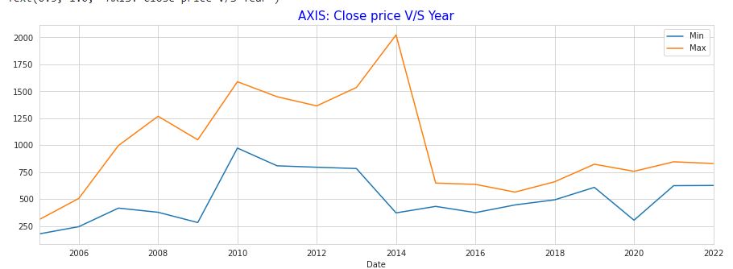
Close price V/s Year
This plot show the minimum and maximum close price for each year.
The max close price recorded is just above 2000 during 2014.
The lowest close price recorded is during 2005.

Slide 11
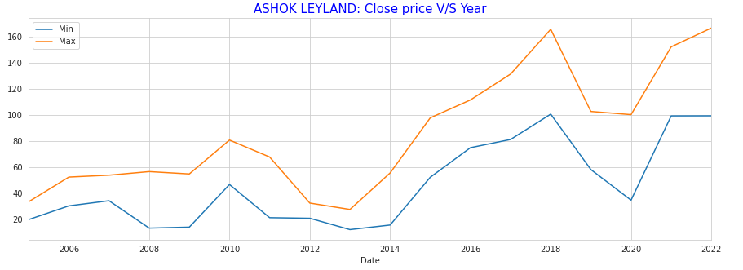
Close price V/s Year
This plot show the minimum and maximum close price for each year.
The Highest Close price was about 170rs in the year 2018.
The lowest close price was observed during the early 2008 and 2013.

Slide 12
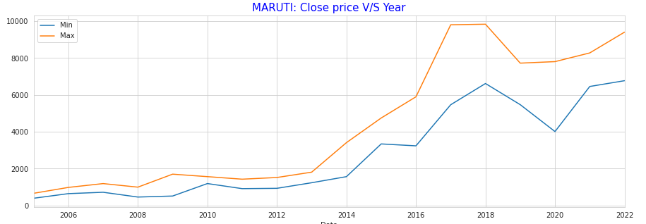
Close price V/s Year
This plot show the minimum and maximum close price for each year.
The highest close price was close to 10K in the year2018.
The lowest close price was observed during the initial 2005 year.

Slide 13
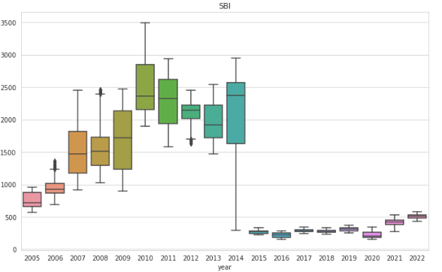
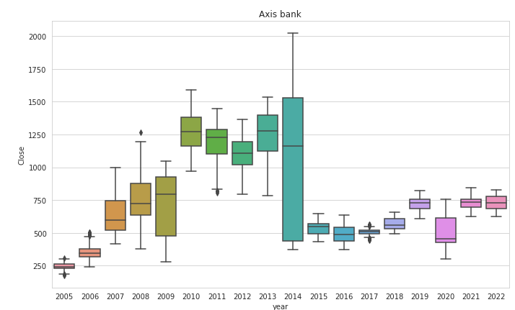
Year Wise Boxplot
In case of the above 2 we observe that the close price has dropped drastically after 2014.
After 2014 the variance of closing price is very low which indicate lesser risk in investing.
The average close price has dropped down after 2014.

Slide 14
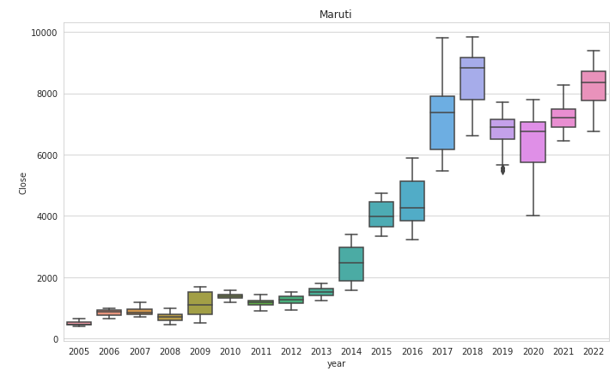
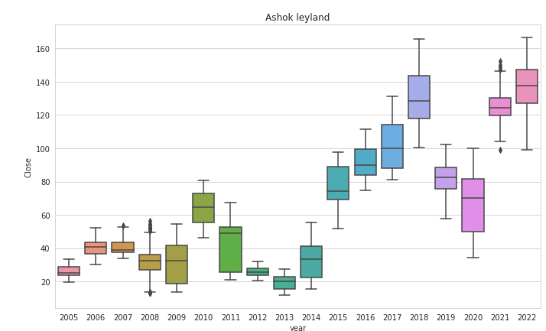
Year Wise Boxplot
There is an overall increasing trend in case of Maruti stock. whereas we observe a minor multiplicative seasonality observed in the case of Ashok Leyland stock.

Slide 15
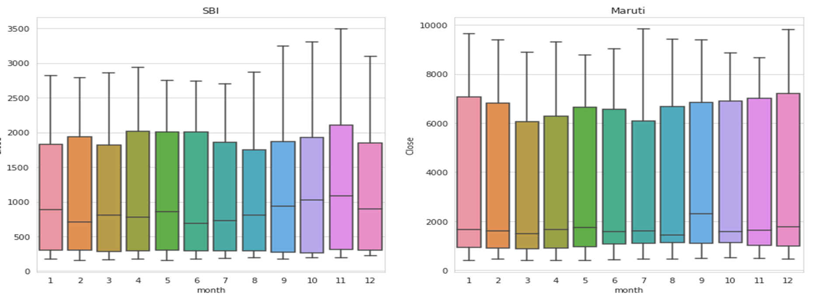
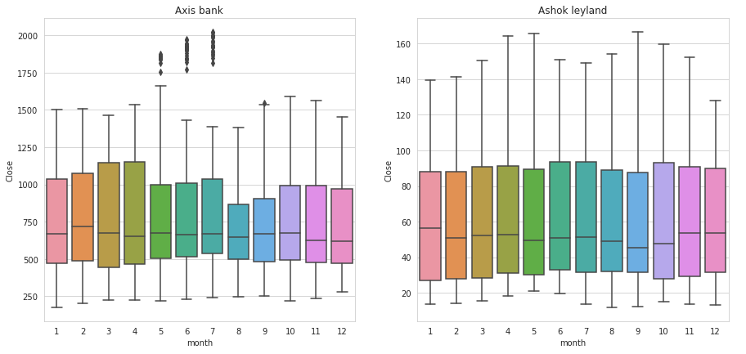
Month Wise Boxplot
This plot gives us idea about the variance of closing price with month

Slide 16
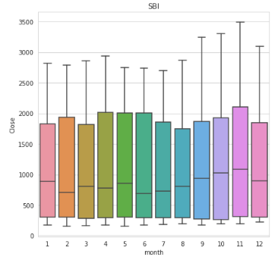
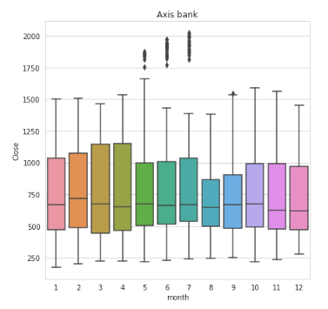
Month Wise Boxplot
This plot gives us idea about the variance of closing price with month

Slide 17
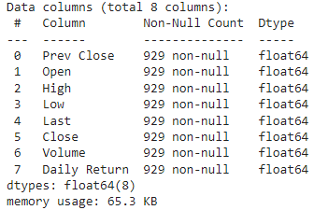
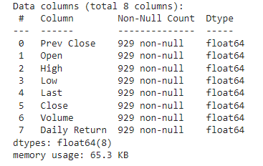
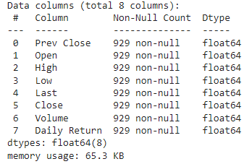
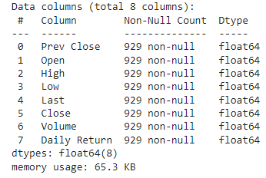
Re-Sampling
We have to down sample the data for Weekly predictions.
Down Sampling using average method
Data points has reduced to 929 rows
SBI
Maruti
Ashok Leyland
Axis Bank

Slide 18
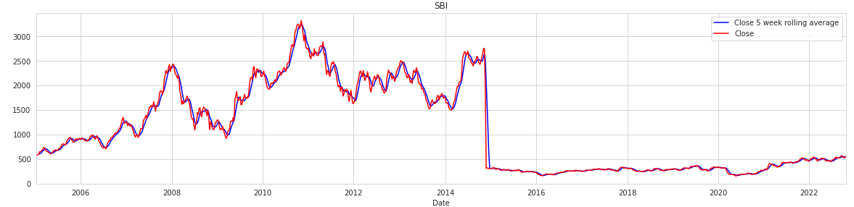
Smoothing: -Simple moving average
The red line show the close price on weekly basis .
The blue line show the 5 rolling average of close price.
The noise /irregularities are removed to an extend.

Slide 19
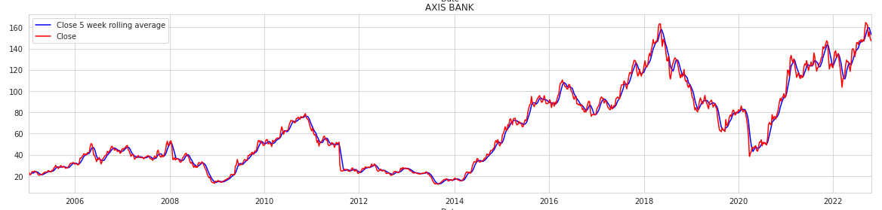
Smoothing: -Simple moving average
The red line show the close price on weekly basis .
The blue line show the 5 rolling average of close price.
The noise /irregularities are removed to an extend.

Slide 20
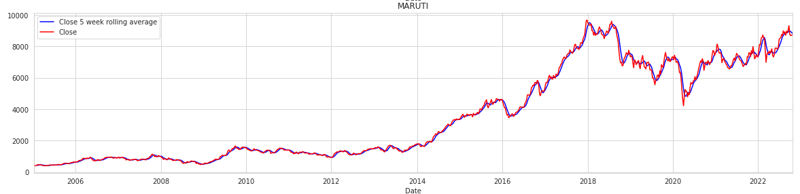
Smoothing: -Simple moving average
The red line show the close price on weekly basis .
The blue line show the 5 rolling average of close price.
The noise /irregularities are removed to an extend.

Slide 21
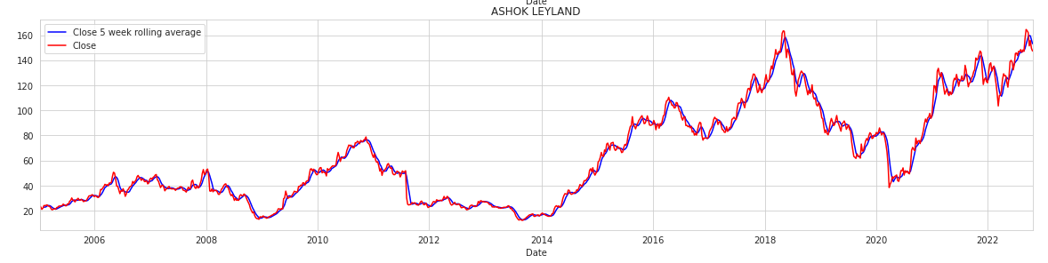
Smoothing: -Simple moving average
The red line show the close price on weekly basis .
The blue line show the 5 rolling average of close price.
The noise /irregularities are removed to an extend.

Slide 22
Splitting The Data
Data Partition Details’
- 70% of the data was used for training
- 30%of the data was used for testing

Slide 23
Model’s Implemented
Linear model
Exponential model
Quadratic model
Additive seasonality
Additive seasonality quadratic
Multiplicative seasonality
Simple exponential smoothing
Holt method
Holt winter method’s
ARIMA
FB prophet
LSTM

Slide 24
Model Evaluations

Slide 25
SBI :Model Wise RMSE Score
Model Name | RMSE
Linear model | 297.63
Exponential model | 375.09
Additive seasonality | 952.43
Additive Seasonality Quadratic | 2510.06
Multiplicative Seasonality | 375.09
Simple Exponential smoothing | 123.89
Holt method | 407.21
Holt winter | 321.21
ARIMA model | 101.25
FB prophet | 218.25
LSTM | 401.49

Slide 26
AXIS Bank: Model Wise RMSE Score
Model Name | RMSE
Linear model | 209.31
Exponential model | 677.44
Additive seasonality | 163.17
Additive Seasonality Quadratic | 1069.24
Multiplicative Seasonality | 677.44
Simple Exponential smoothing | 155.58
Holt method | 1054.66
Holt winter | 619.18
ARIMA model | 90.37
FB prophet | 199.83
LSTM | 684.89

Slide 27
Maruti: Model Wise RMSE Score
Model Name | RMSE
Linear model | 750.97
Exponential model | 7185.65
Additive seasonality | 4569.43
Additive Seasonality Quadratic | 5228.72
Multiplicative Seasonality | 7185.65
Simple Exponential smoothing | 970.86
Holt method | 3227.28
Holt winter | 7129.71
ARIMA model | 136.45
FB prophet | 1421.00
LSTM | 7477.55

Slide 28
Ashok Leyland :Model Wise RMSE Score
Model Name | RMSE
Linear model | 28.34
Exponential model | 102.97
Additive seasonality | 57.90
Additive Seasonality Quadratic | 68.93
Multiplicative Seasonality | 102.97
Simple Exponential smoothing | 35.53
Holt method | 56.14
Holt winter | 56.14
ARIMA model | 3.06
FB prophet | 40.53
LSTM | 117.22

Slide 29
Top 3 Models Based on RMSE: 1. ARIMA 2. Simple Exponential smoothing 3. FB Prophet

Slide 30
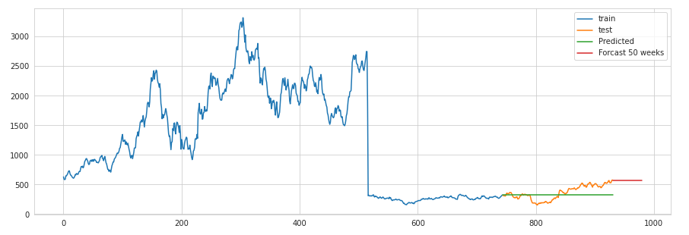
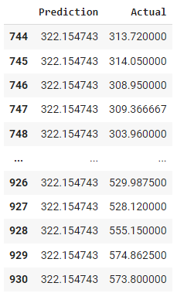
Simple exponential smoothing : SBI
RMSE: 123.89
The blue region is the training set ,The orange region is the testing set
The green line is the predicted region-Its is having a constant value /trend
So this model is inefficient for forecasting

Slide 31
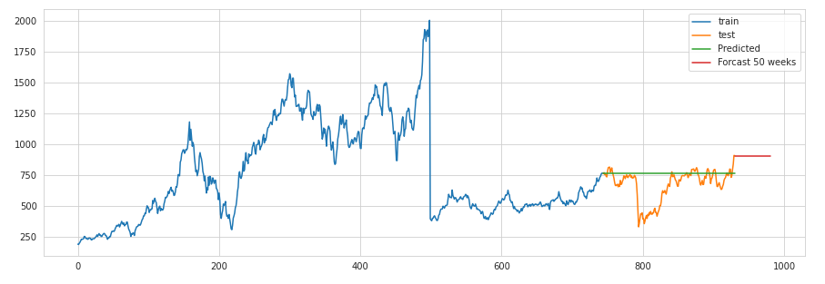
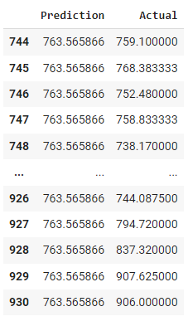
Simple exponential smoothing : Axis
RMSE: 155.58
The blue region is the training set ,The orange region is the testing set
The green line is the predicted region-Its is having a constant value /trend
So this model is inefficient for forecasting

Slide 32
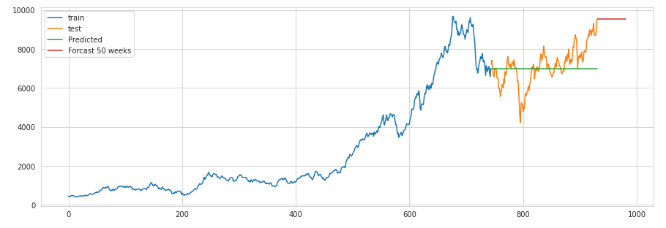
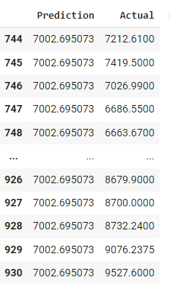
Simple exponential smoothing : Maruti
RMSE: 970.46
The blue region is the training set ,The orange region is the testing set
The green line is the predicted region-Its is having a constant value /trend
So this model is inefficient for forecasting

Slide 33
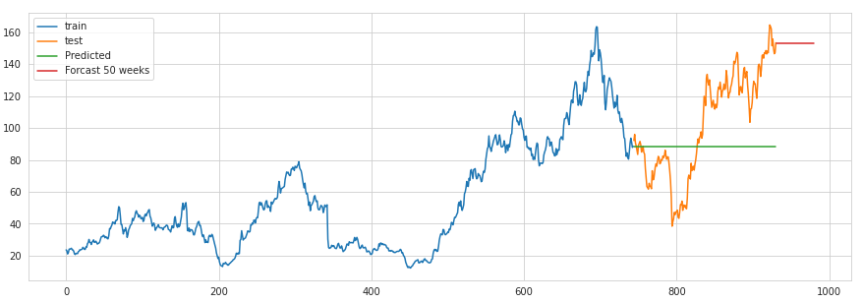
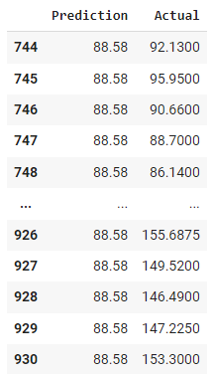
Simple exponential smoothing : Ashok leyland
RMSE: 35.53
The blue region is the training set ,The orange region is the testing set
The green line is the predicted region-Its is having a constant value /trend
So this model is inefficient for forecasting

Slide 34
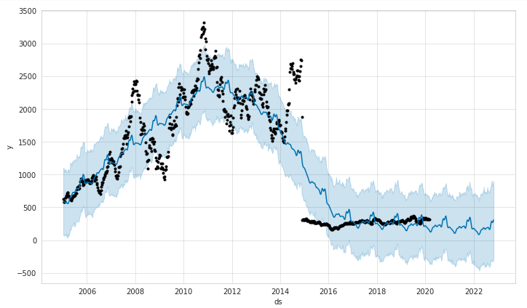
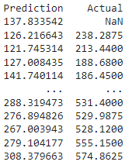
FB Prophet model : SBI
RMSE: 234.73
The black dot are the actual value, and the blue line are the predicted values

Slide 35
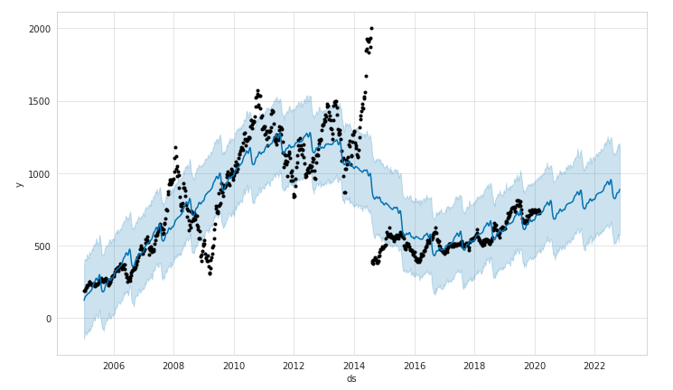
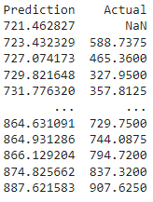
FB Prophet model : AXIS
RMSE: 196.83
The black dot are the actual value, and the blue line are the predicted values

Slide 36
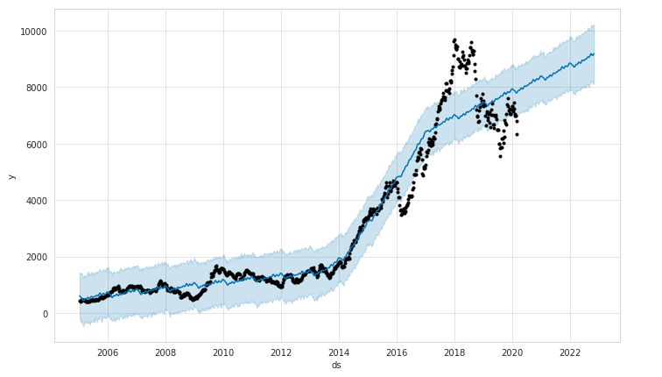
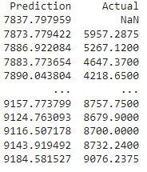
FB Prophet model : Maruti
RMSE : 1472
The black dot are the actual value, and the blue line are the predicted values

Slide 37
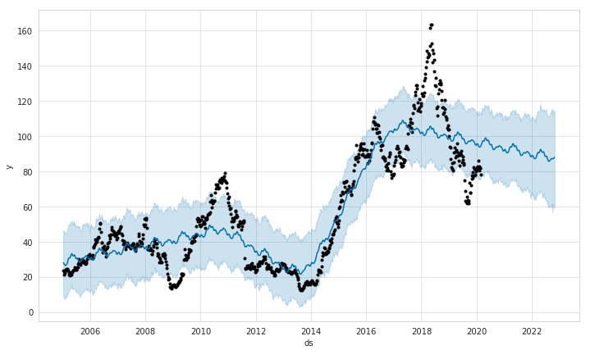
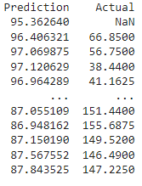
FB Prophet model : Ashok Leyland
RMSE : 41.28
The black dot are the actual value, and the blue line are the predicted values

Slide 38
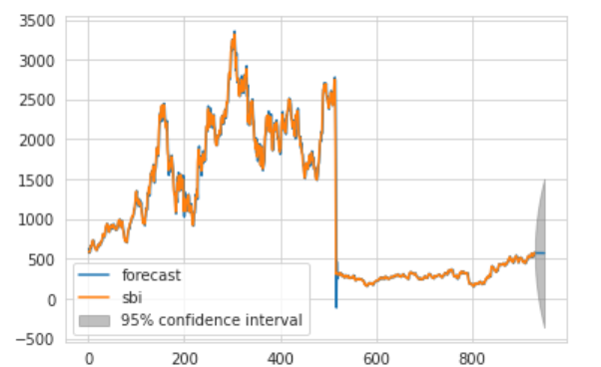
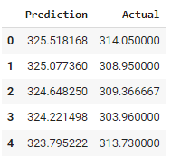
ARIMA: SBI
The orange line is the actual close price
The blue line is the predicted value and
The grey region is the 95% confidence interval
RMSE :101.25

Slide 39
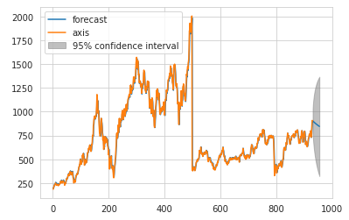
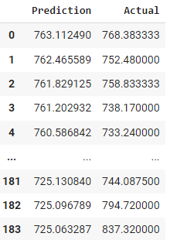
ARIMA: AXIS
The orange line is the actual close price
The blue line is the predicted value and
The grey region is the 95% confidence interval
RMSE :90

Slide 40


ARIMA: Maruti
The orange line is the actual close price
The blue line is the predicted value and
The grey region is the 95% confidence interval
RMSE :136

Slide 41


ARIMA: Ashok Leyland
The orange line is the actual close price
The blue line is the predicted value and
The grey region is the 95% confidence interval
RMSE : 3.06

Slide 42


Augmented Dickey-Fuller
To check whether the data is stationary or not
If not to find the difference or d-value for ARIMA model
Leyland data set became stationary after differencing of 1 shift
d value=1
Maruti data set became stationary after differencing of 1
d value=1

Slide 43


Augmented Dickey-Fuller
Maruti data set was stationary without differencing
d value=0
SBI stock became stationary after differencing it by 1 shift
d value=1

Slide 44




ACF and PACF Plots
SBI
AXIS
Maruti Suzuki India Ltd
Ashok Leyland
The ACF & PACF plot helps to find the P-value and Q-value

Slide 45
ARIMA Model Configuration
ARIMA Order (p, d, q)
-SBI : (1,1,1)
-AXIS Bank : (1,0,0)
-Maruti : (0,1,1)
-Ashok Leyland : (1,1,1)

Slide 46
Model Deployment
Based on the evaluations metrics ARIMA model is the best model as it is giving the least RMSE value and significant forecast values.
Deployed the model using streamlit.

Slide 47


Select stock from the drop down.
Give’s the status of the data extraction.
Give’s the logo & brief summary of the selected stock

Slide 48


Display’s the head of the Data Frame.
Give’s the total no: of data points extracted.
Line plots show the Close price of the selected stock.
The orange line show the forecast values.

Slide 49

A slider has been provider for the selecting the forecast
Max 12 weeks of forecasting can be done (3 months)
Given below is the forecasted Close price

Slide 50
Challenges Faced:-
Issues with extraction of data using NSEPY
Selection of final model.
Issue’s with fb Prophet module
How did you Overcome?
Run the code multiple times.
Selected model with least RMSE value and significant forecasted values.
Installed a lower version of the same.

Slide 51
Thank You

